Slide 1
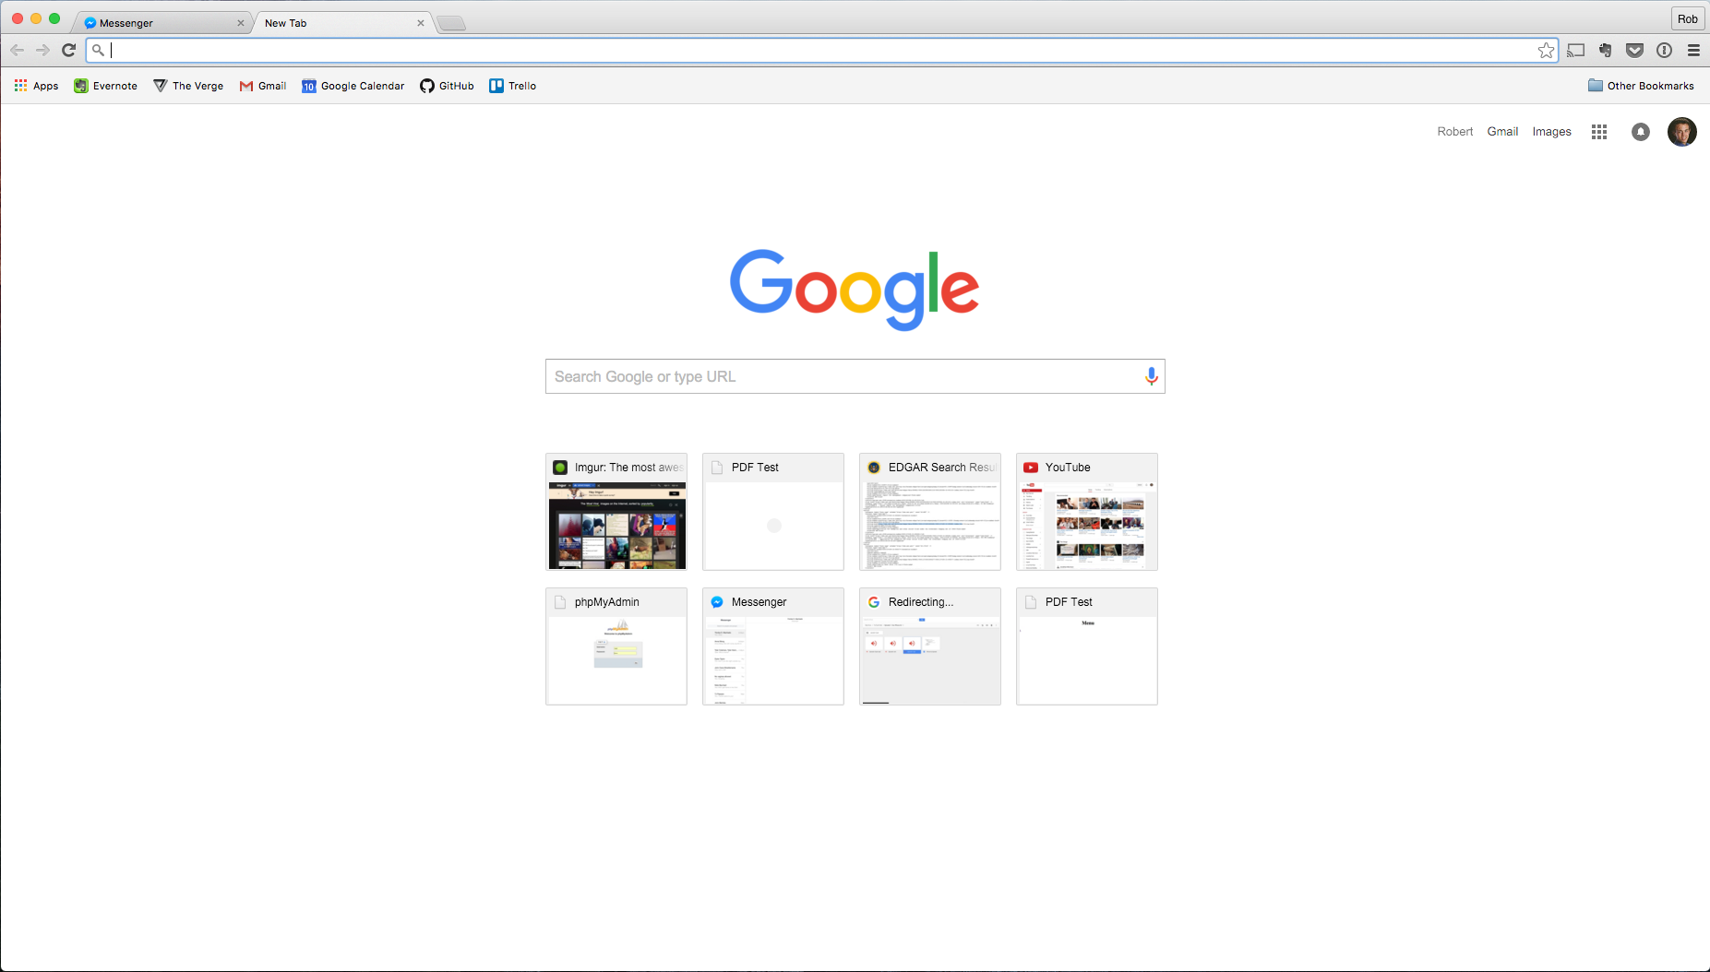
https://grogro.io
grogro
About Lists Login/Signup
Search
Grogro List
Pizza
Milk
Eggs
Ham
Turkey
Ice Cream
Oreo’s
Salad
Brussel Sprouts
Burritos
Gatorade
Almonds
Water

